Slide 1
INTRODUCTION TO RELATIONAL DATABASES

Slide 2
Why are Databases important?
Most IT systems and applications use a backend database to store and manage their data and support the functionality of those applications. All of the following use databases:
Social media apps (Facebook, Instagram Twitter, LinkedIn, WhatsApp)
Online banking
Web applications such as online booking and shopping sites
Line of business applications (HR, Finance, Student Records, Marketing, Order Processing)
Online games
Data warehouses to support reporting and business intelligence.
Big Data applications
Databases are used almost everywhere in our lives.
ISON WITH LAST YEAR

Slide 3
Types of databases
There are many types of databases, each one being more appropriate to different types of applications but simply speaking there are two main types:
Relational databases (better for structured data)
Non-relational / NoSQL databases (better for unstructured or semi-structured data)
Databases can be stored on local servers or in the cloud.
They can be centralised in one location or distributed across different locations.
We will concentrate on relational databases on this unit.
ISON WITH LAST YEAR

Slide 4
What is a relational database?
ISON WITH LAST YEAR
A relational database is one in which the data consists of a ‘collection of tables linked by common data values’
The two most prominent characteristics of a relational database are:
data stored in tables
relationships between tables

Slide 5
Examples of relational databases
There are hundreds of different relational databases and variants but these are some of the most popular:
Oracle
Microsoft SQL Server
MySQL
PostgreSQL
DB2
Informix
Amazon RDS
MariaDB
SQLite
ISON WITH LAST YEAR

Slide 6
tables
A table (or relation) is a set of data about instances of a particular entity (e.g. employees)
An attribute (or column) represents a characteristic of an item (e.g. the employee’s job title)
A record (or row) represents the set of values (all the columns) for a particular instance (e.g. one employee)
To maintain integrity, each individual record should be uniquely identified
ISON WITH LAST YEAR

Slide 7
An example table
Employees
ISON WITH LAST YEAR
ID value uniquely
identifying each row
An attribute
(or column)
A record
(or row)

Slide 8
Database integrity
In order to maintain the integrity of a relational database, each table should have a primary key column that uniquely identifies each row e.g. a customer_id which is unique to each customer. This is called entity integrity.
In any other tables where that primary key column appears, a foreign key is created to ensure that any value entered exists in the primary key table e.g. a customer_id in an Order table should be a valid customer_id that exists in the customer table. This is called referential integrity.
There are other ways that the integrity of the database can be maintained which we will explore later in the unit.
ISON WITH LAST YEAR

Slide 9
relationships
Relationships exist between tables to represent the links between business entities e.g. a department has many employees and a customer has many orders.
Relationships are usually one to many (written as 1:m) e.g one department has many employees. Note ‘many’ can be 1 or more.
Relationships are implemented using common columns between two tables e.g. the deptno primary key column in the dept table with the deptno (foreign key) in the emp table
Relationships allow tables to be joined together in SQL Queries.
ISON WITH LAST YEAR

Slide 10
An Example relationship
Deptno (Foreign key)
Deptno (Primary Key)
EMP table
matches
DEPT table
Note: King, Clark and Miller are all in department 10
From the dept table
we can see that this is Accounting and is located in Oxford.
Therefore King Clark and Miller all work for Accounting and are located in Oxford.
One to many (1:m)
One department (Accounting)
has many employees (King, Clark, Miller)
ALSO
One employee (King) works for one department (Accounting)

Slide 11
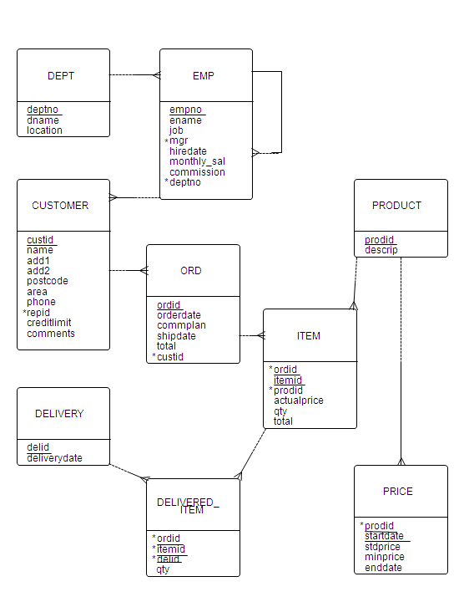
Entity relationship diagram (ERD)
Each box represents a table (entity)
The table name is shown at the top.
In the bottom half of the box, the attribute (column) names of the table are listed.
The underlined attribute(s) is/are the Primary Key to uniquely identify each row in a table
Attributes marked with an asterisk (*) are Foreign Keys which are used to link to primary key values in another table
The MySports Data Model

Slide 12
Entity relationship diagram (ERD)
The lines between the boxes represent the relationships between the tables.
The ‘crows foot’ indicates the many end of the relationship e.g one dept has many emp records
The ‘loop’ on the emp table means that the table has a relationship with itself. Here many employees are managed by one manager (who is also an employee).
The MySports Data Model

Slide 13
Many to many relationships
The real world is full of many to many (m:m) relationships, for example:
Library system: a book is borrowed by many members and a member borrows many books
Ordering system: one order is for many products and a product is included in many orders
Many to many (m:m) relationships cannot be directly implemented in a relational database.
To implement an m:m relationship we must use a ‘link entity’ between the two tables that need a m:m relationship. For example, an item table is created as the ‘link entity’ between product and order.
Each order contains many items, each of which is linked to a product
Each product is referenced by many items each of which is linked to one order
Part of MySports ERD
link entity at the many end of two relationships (crows feet = ‘many end’ of relationship)

Slide 14
Many to many relationships
Part of MySports ERD
The link entity creates not only an explicit m:m relationship between order and product but also an implicit m:m relationship between customer and product
Each product is referenced by many items, each of which is linked to one order, one order is linked to one customer = each product is ordered by many customers
Each customer has many orders, each of which includes many items, one item is linked to one product = each customer orders many products
= m:m relationship between customer and product (as well an m:m relationship between order and product).
link entity at the many end of two relationships (crows feet = many end of relationship)

Slide 15
summary
In a relational database data is stored in tables (entities)
Each table has a defined number of attributes (columns)
Note: a table can contain as many records (rows) of data as necessary but each record in the table will contain the same attributes (column)
Relationships are implemented using matching values between tables
Relationships are normally one to many (1:m)
Many to many (m:m) relationships are implemented using link entities that create implicit as well as explicit m:m relationships
An Entity Relationship Diagram (ERD) shows the tables that make up a database and the relationships between them

